Slide 1


SMART INDIA HACKATHON 2025
BloodLens AI
Problem Statement ID – SIH25131
Problem Statement Title- Student Inovation
Theme- MedTech/BioTech/HealthTech
PS Category- Software
Team ID- 54108
Team Name- CodeX

Slide 2
BloodLens AI
CodeX
Proposed Solution
We propose a Deep Learning-based software that analyzes microscopic images of blood samples.
Instead of traditional manual testing with syringes and labs, the system requires only a microscopic image.
Ensures accessibility in rural and resource-limited areas where labs are short.
Provides faster diagnosis, eliminating delays caused by manual methods.
First of its kind approach combining microscopic images and real time AI detection.
Portable and cost effective: It only requires a microscope, camera and software.

Slide 3
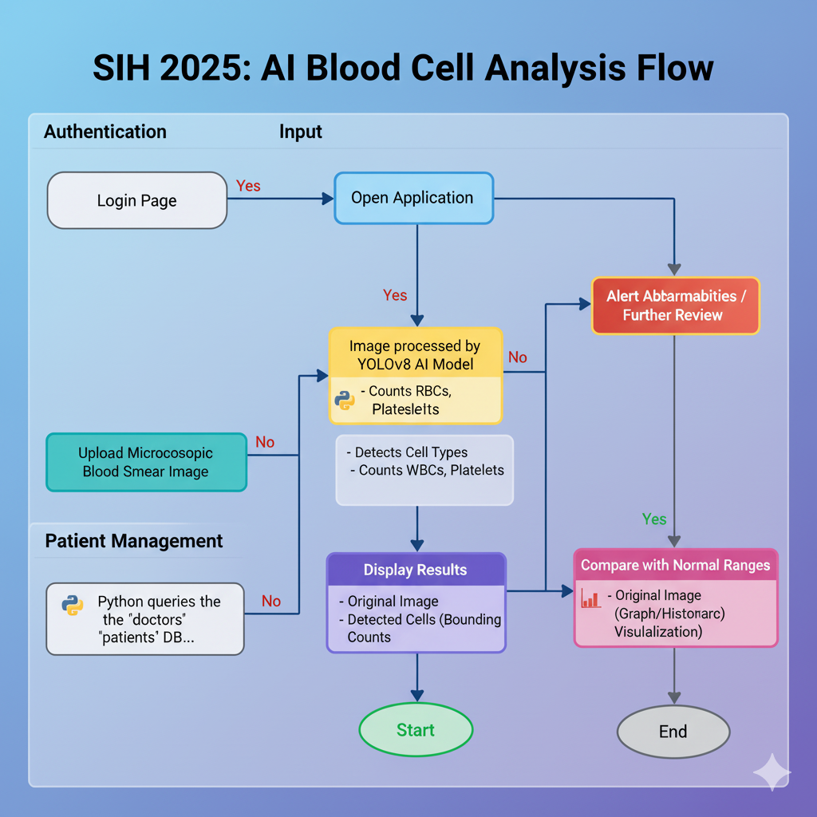
TECHNICAL APPROACH
CodeX
Technologies Used Flowchart
Frontend
HTML
CSS
JavaScript
Backend
Flask
Python
OpenCV
Tensorflow
YOLOv8
Scikit-Learn
Pytorch

Slide 4
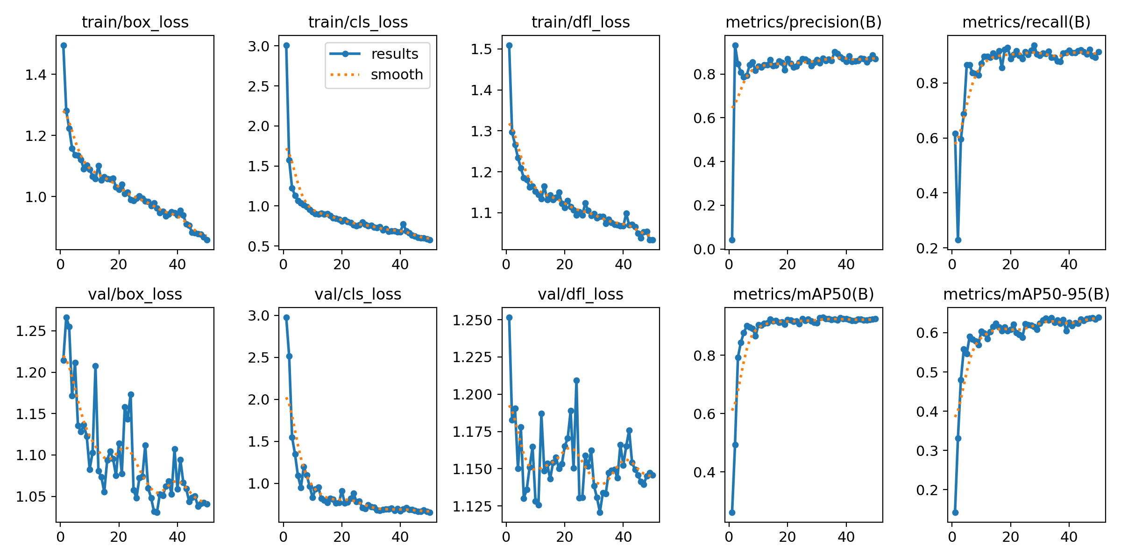
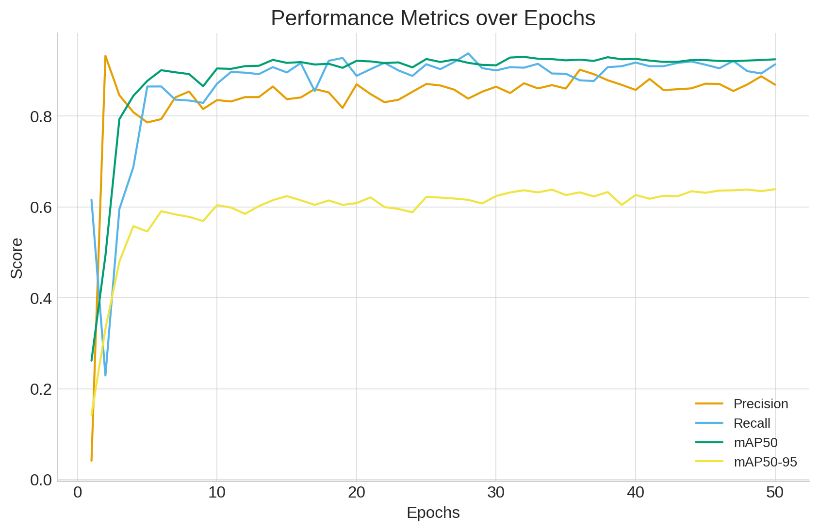
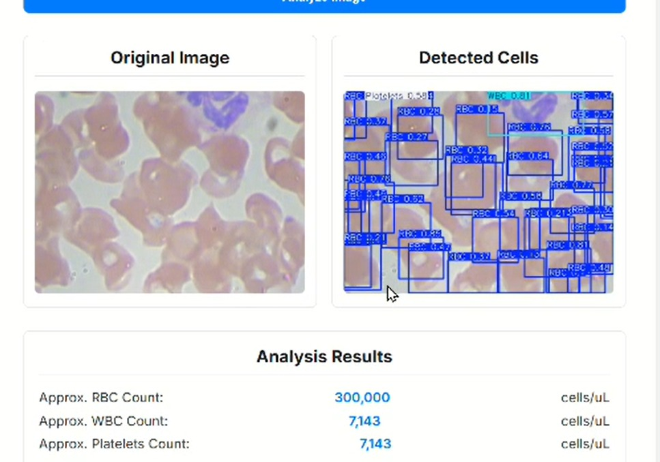
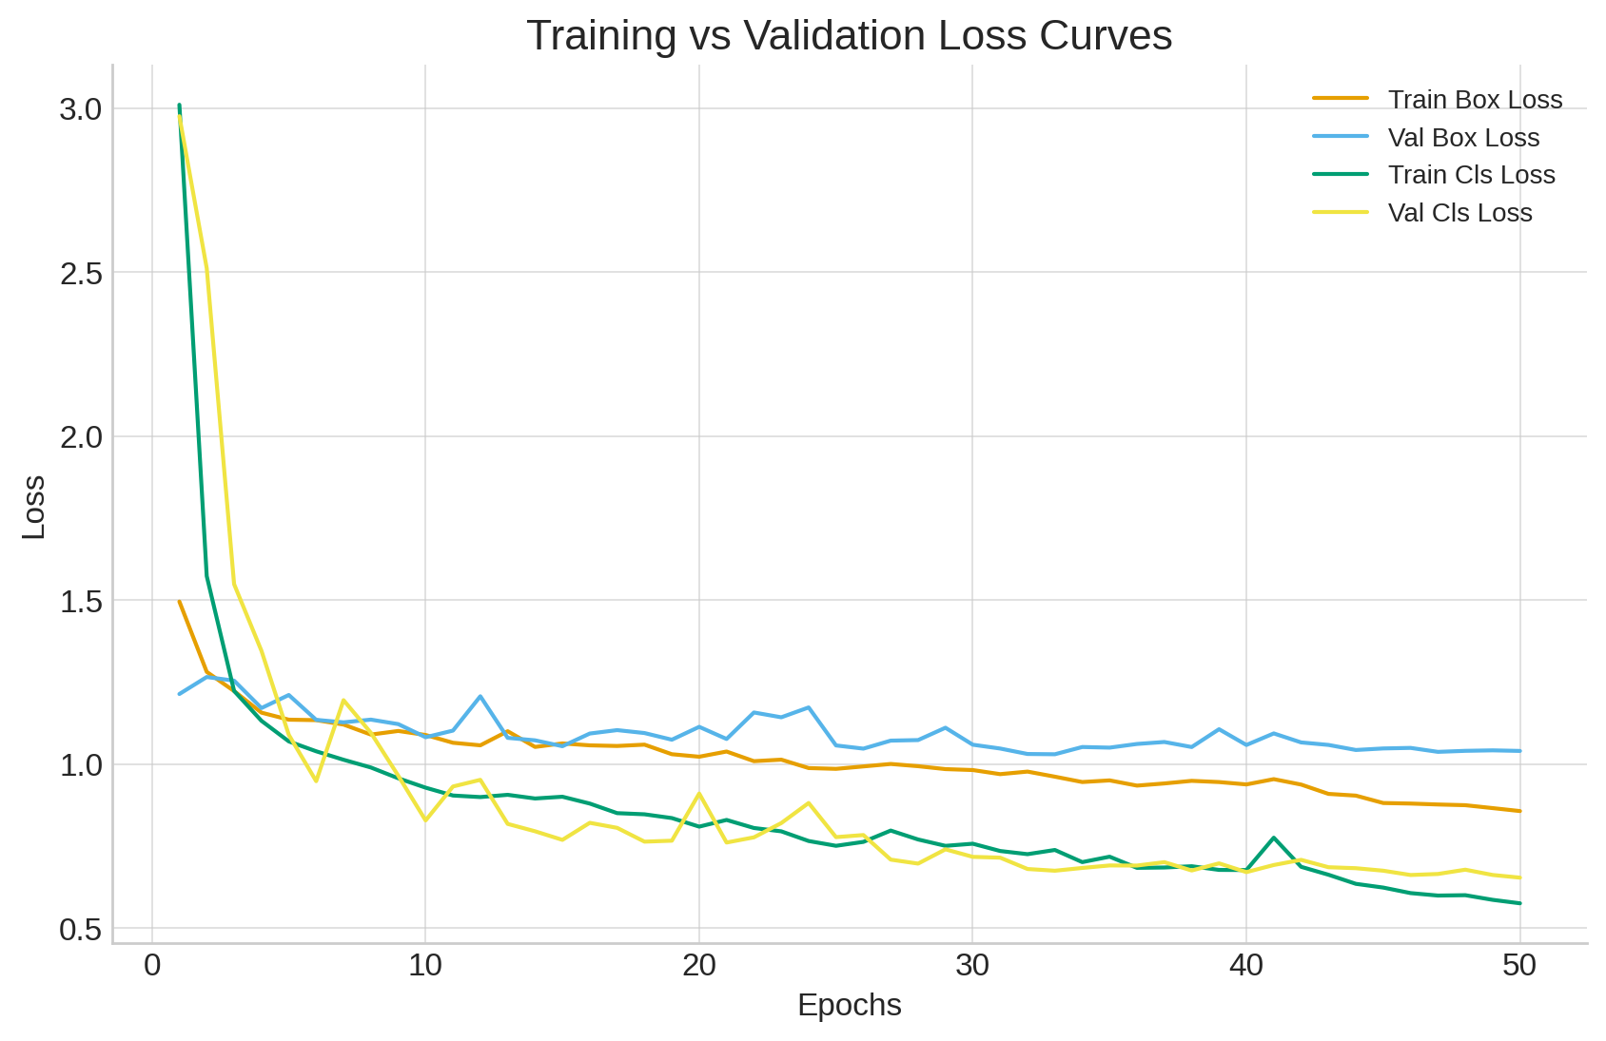
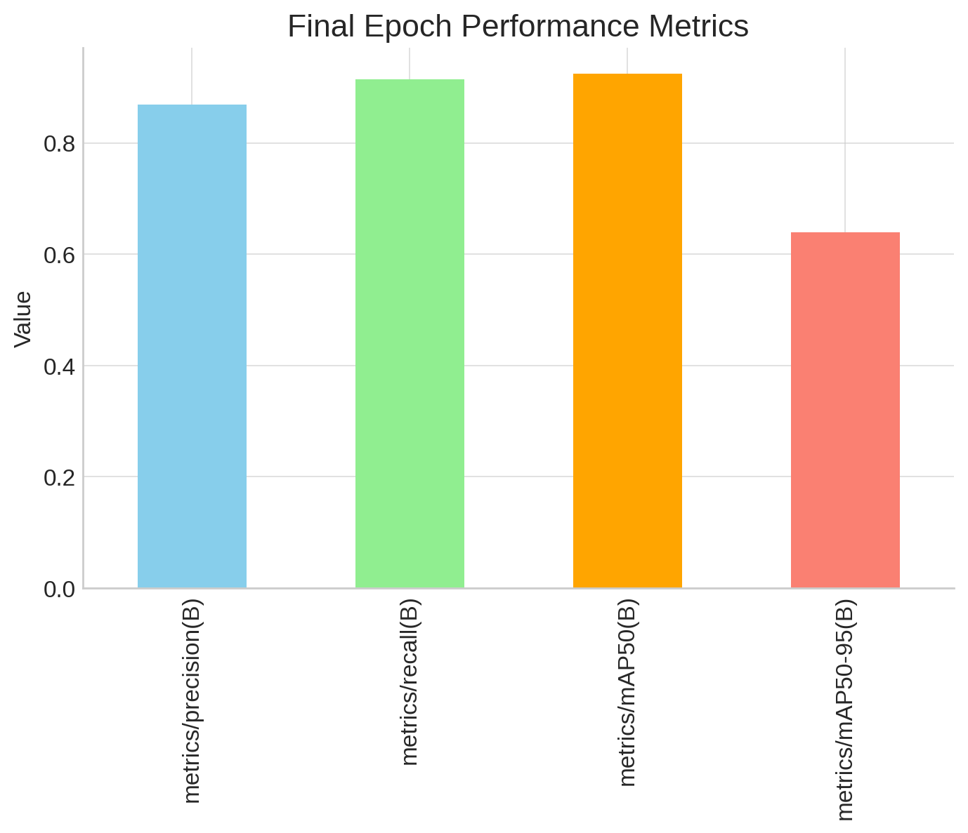
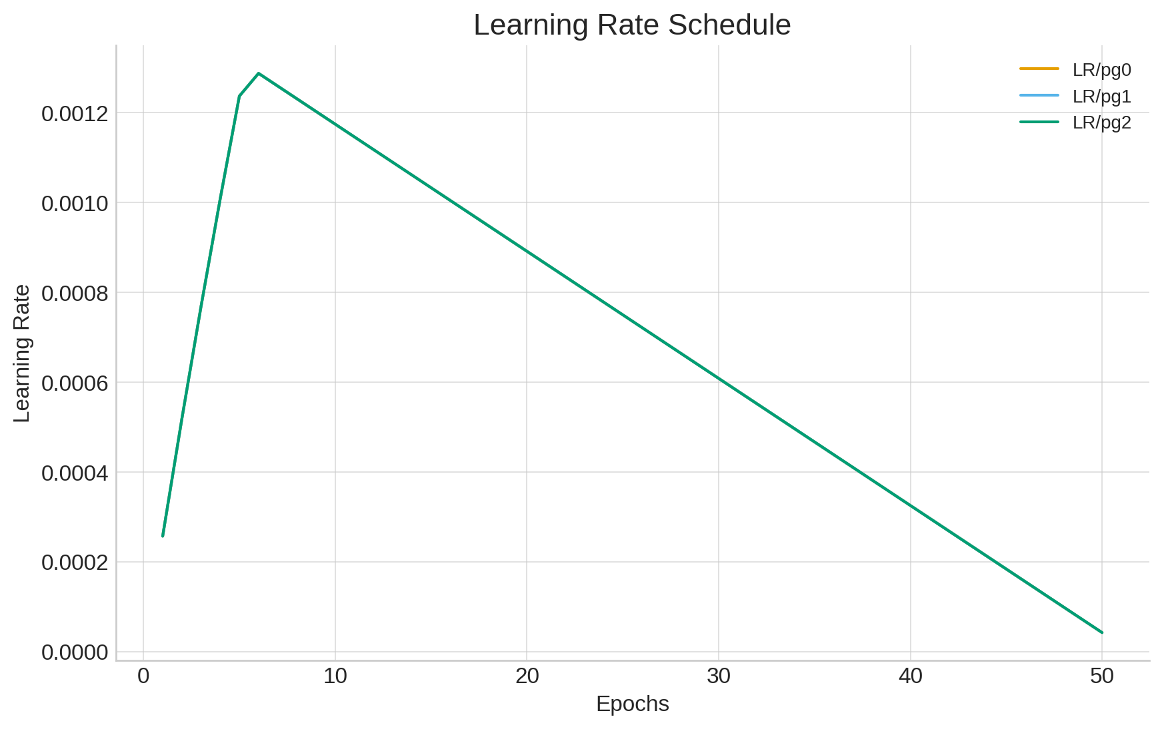
Results and Analysis
CodeX

Slide 5
IMPACT AND BENEFITS
CodeX
Potential impact on the target audience
Provides fast and reliable diagnosis to patients.
Enables rural healthcare centers to perform blood tests without advanced labs.
Saves critical time in emergency cases, improving patient survival chances.
Benefits of the solution
Social- Brings advanced healthcare to underserved and rural areas.
Economic- Reduces costs of labs testing and hospital resources.
Environmental- Minimizes use of consumables (test kits) i.e. eco-friendly.
Future Scopes
We’ll detect diseases like Malaria, Anemia and it’s different types.
The model will be integrated through a digital microscope and can be used directly through smartphones.

Slide 6
RESEARCH AND REFERENCES
CodeX
Shenggan. BCCD Dataset; 2017. Available from: https://github.com/Shenggan/BCCD_Dataset.
https://www.tensorflow.org/lite/models/modify/model_maker/object_detection
Reddy, K Venkata Shiva Rama Krishna et al Malaria Parasite Detection in Thick Blood Smears Using Deep Learning International Journal of Engineering and Advanced Technology
Kiggundu, M., Nsobya, S.L., Kamya, M.R., Filler, S., Nasr, S., Dorsey, G. and Yeka, A. Evaluation of a comprehensive refresher training program in malaria microscopy covering four districts of Uganda. The American journal of tropical medicine and hygiene, 84(5), p.820, 2011.

